Slide 1
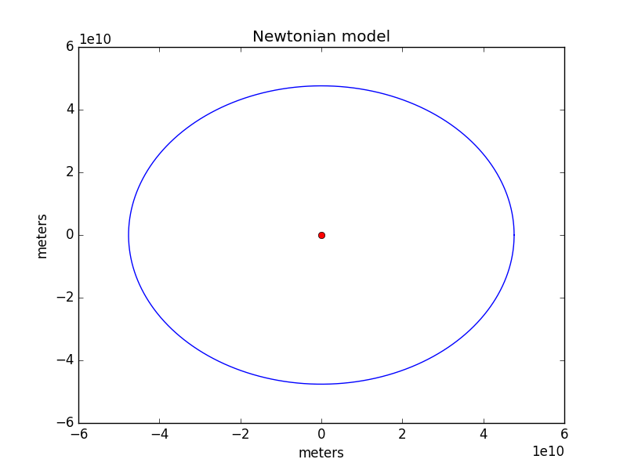
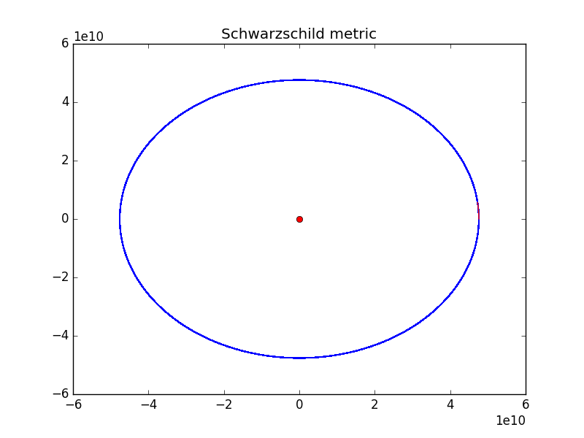
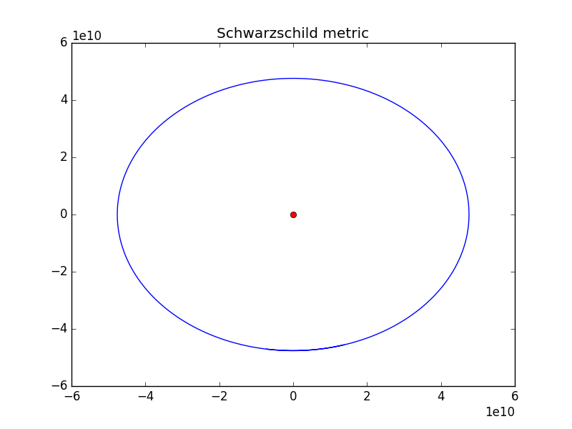
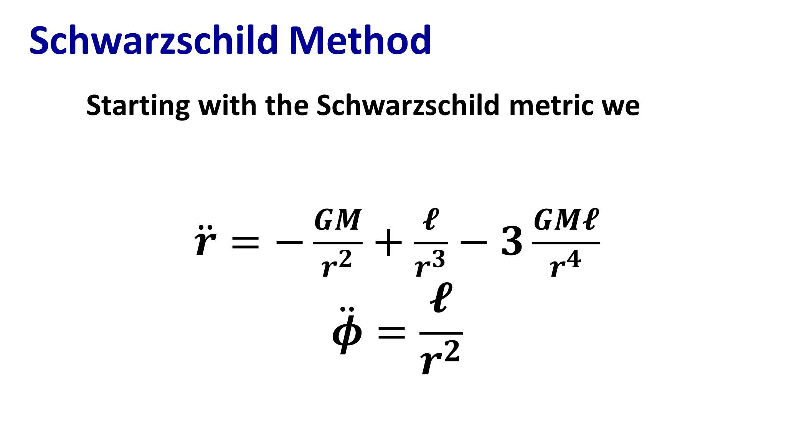
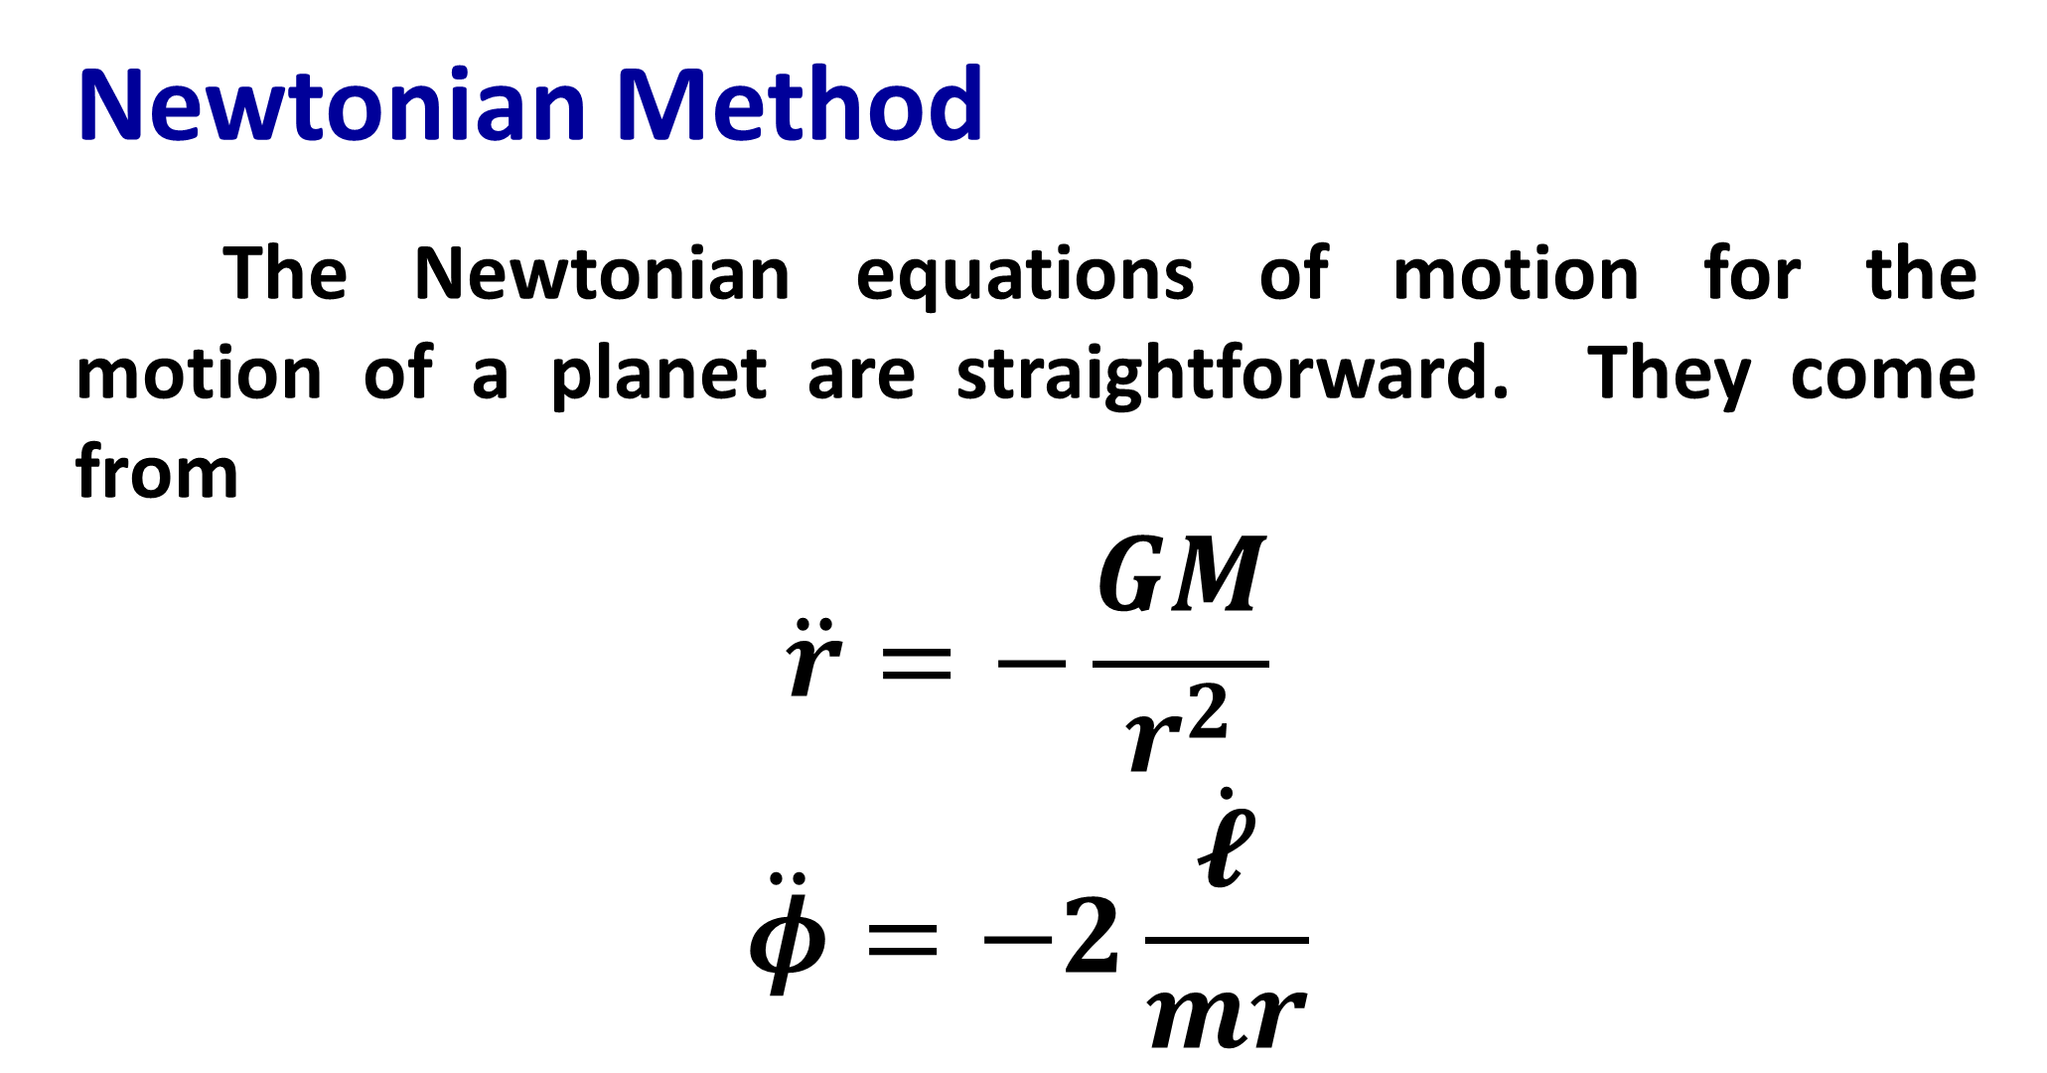
Two methods of determining the orbit of Mercury
Ian Blackstone
Lab Logo
Institution Logo
Project Introduction
This projects looked at two different sets of differential equations for calculating the orbit of Mercury about the Sun, one as well as two methods of calculating the obit given these equations.
This first of these methods uses a set of equations derived from Newtonian physics, while the second uses equations derived from the Schwarzschild metric in general relativity. The aim is to visualize the different outcomes based on the model being used.
Comparing the Two Plots
Missing Precession
The main motivation for modeling the orbit of mercury using general relativity is to show the precession of Mercury’s orbit, however that precession is missing from the odeint method as shown in this plot, which models the orbit of Mercury for 150 years. Longer run times are infeasible as memory overflow errors prevent the code from be
Newtonian Method
The Newtonian equations of motion for the motion of a planet are straightforward. They come from
$$\ddot{r}=−\frac{GM}{r^{2}}$$
$$\ddot{φ}=−2\frac{\dot{𝓵}}{mr}$$
Figure 1. A single orbit using the Newtonian method
Schwarzschild Method
Starting with the Schwarzschild metric we
$\ddot{r}=−\frac{GM}{r^{2}}+\frac{𝓵}{r^{3}}−3\frac{GM𝓵}{r^{4}}$
$$\ddot{φ}=\frac{𝓵}{r^{2}}$$
Figure 3. Mercury’s orbit over 622 orbital periods. No precession occurred during this time.
Conclusion
For long term modeling of Mercury’s orbit new methods will need to be investigated, the most promising method is the IAS15 integrator built specifically to handle gravitational dynamics (Rein, Spiegel, 2014). The regular ode functions of numpy are not accurate enough and have high memory demands over long time periods.
Acknowledgments
Thank you to Dr. Macomb and Dr. Jackson for their input and help with this project.
References
Rein, H. Spiegel, D. IAS15: a fast, adaptive, high-order integrator for gravitational dynamics, accurate to machine precision over a billion orbits. MNRAS, Oct 2014.
Moore, T. A General Relativity Workbook. University Science Books, Sep 2012.
Figure 2. A single orbit using the Schwarzschild method

